Slide 1
How are you?
A Mental Health Screening Tool
UML Entity Relationship Diagrams
Presented By
1705003 - Mahdi Hasnat Siyam

Slide 2
To be designed as a part of
CSE326 Information System Design Project
1705001 - Kowshic Roy
1705002 - Sheikh Azizul Hakim
1705003 - Mahdi Hasnat Siyam
1705008 - Sheikh Saifur Rahman Jony
1705015 - Zaber Ibn Abdul Hakim
1705024 - Khandokar Md Rahat Hossain

Slide 3
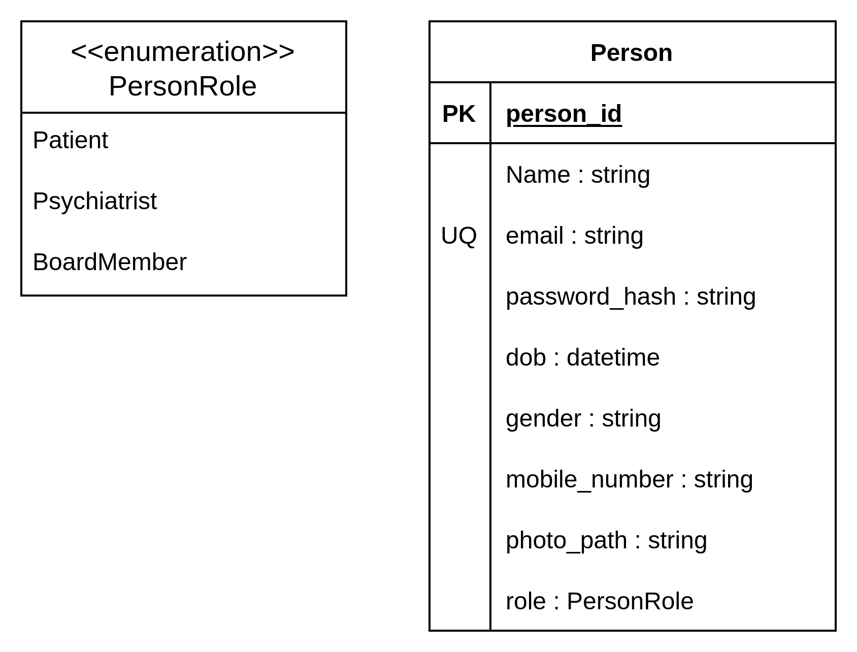
Person Table

Slide 4
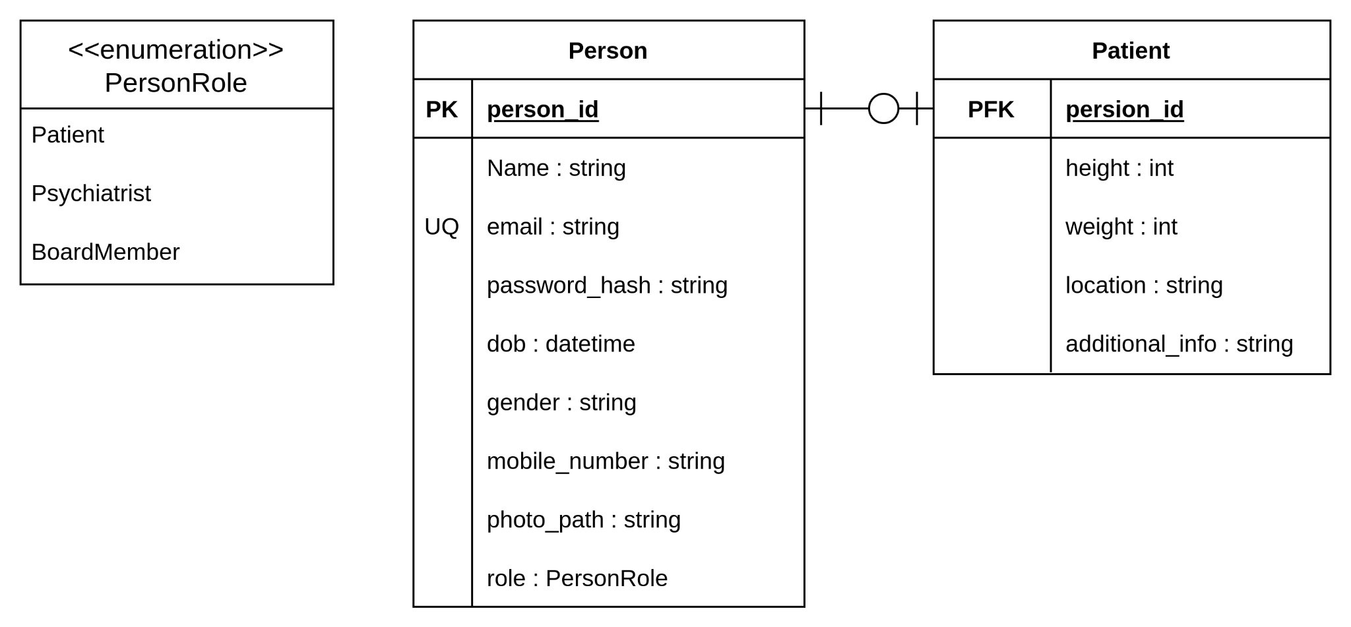
Patient Table

Slide 5
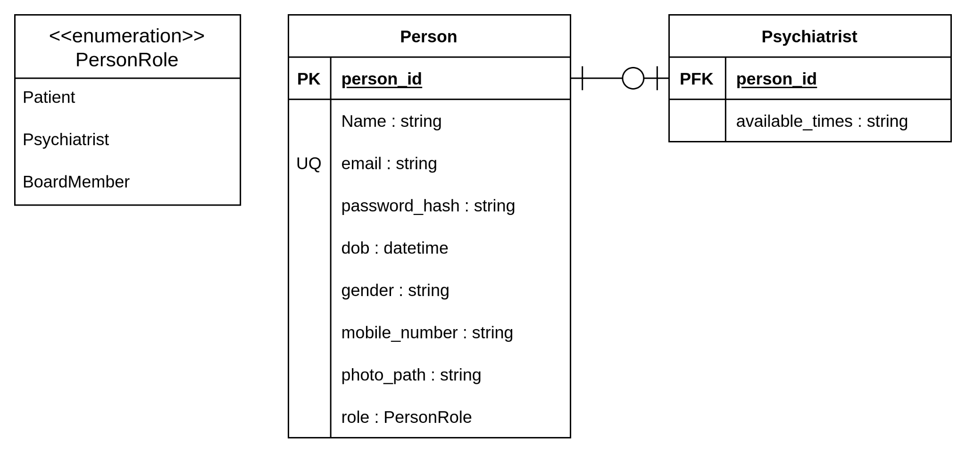
Psychiatrist Table

Slide 6
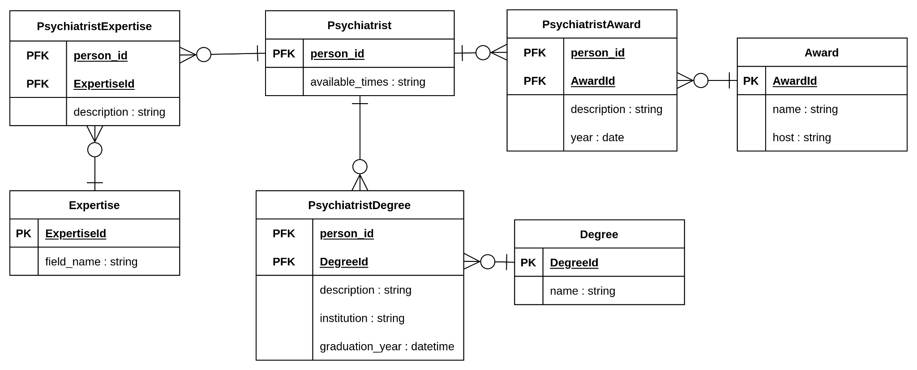
Attributes of Psychiatrist

Slide 7
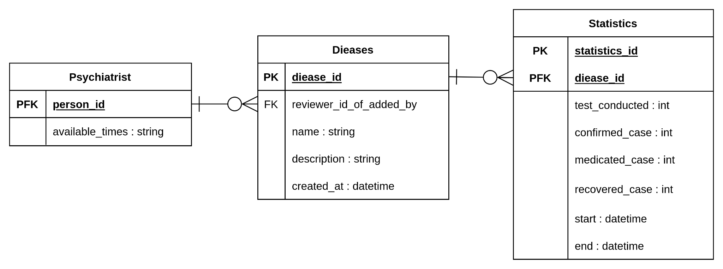
Disease and Statistics

Slide 8
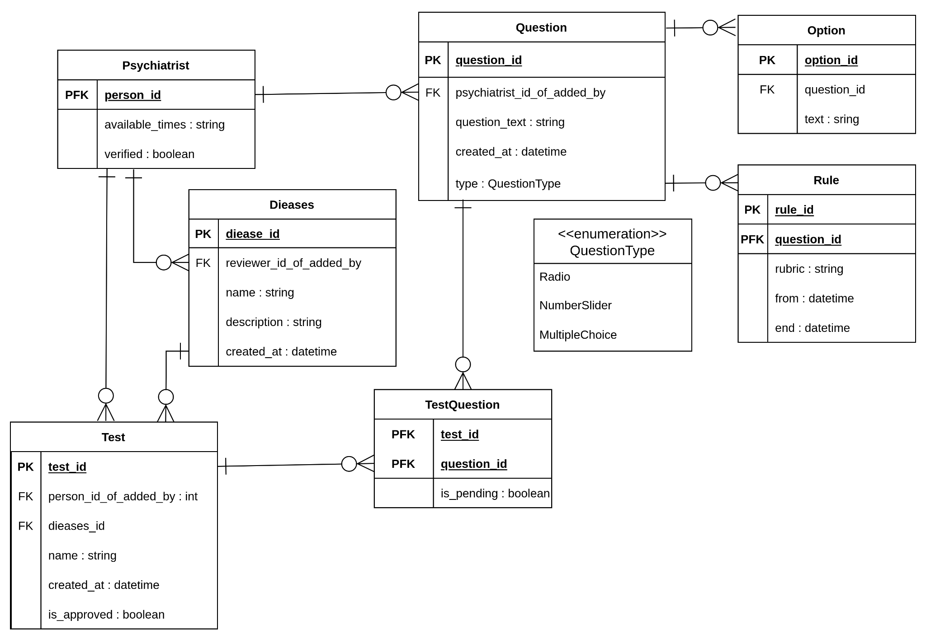
Test & Question

Slide 9
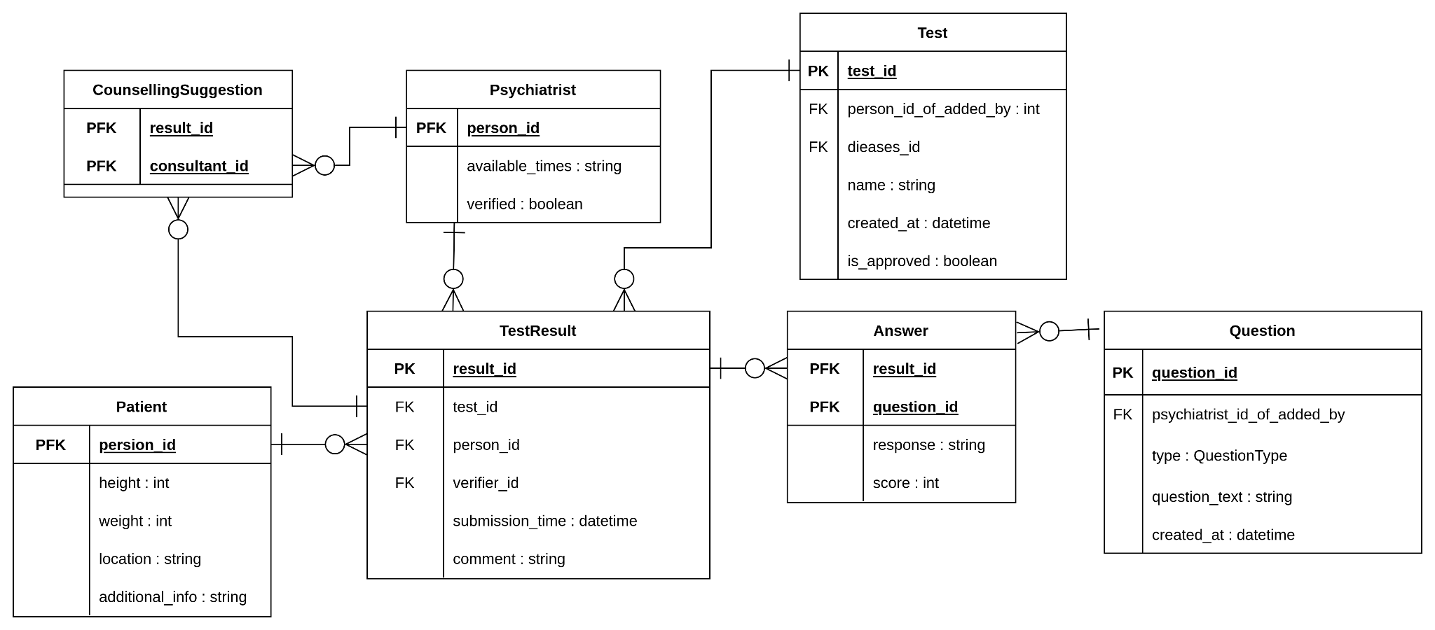
TestResult

Slide 10
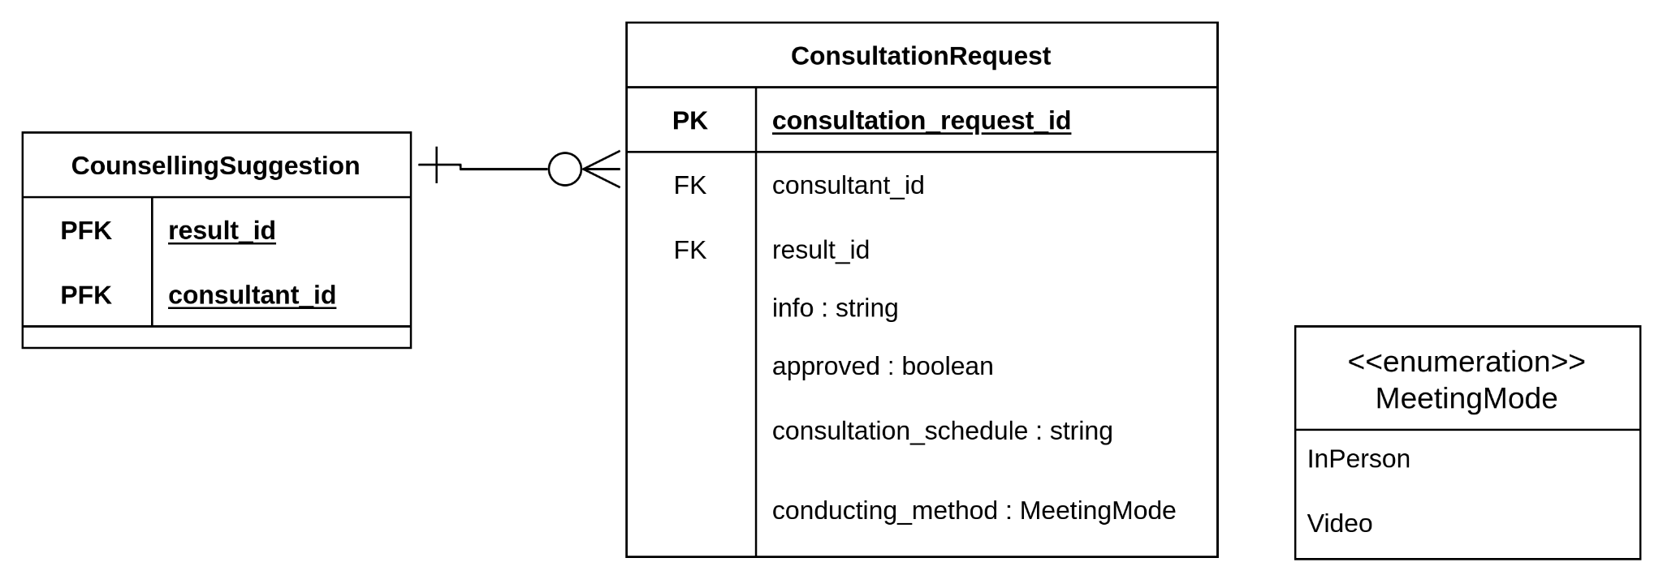
Consultation Request

Slide 11
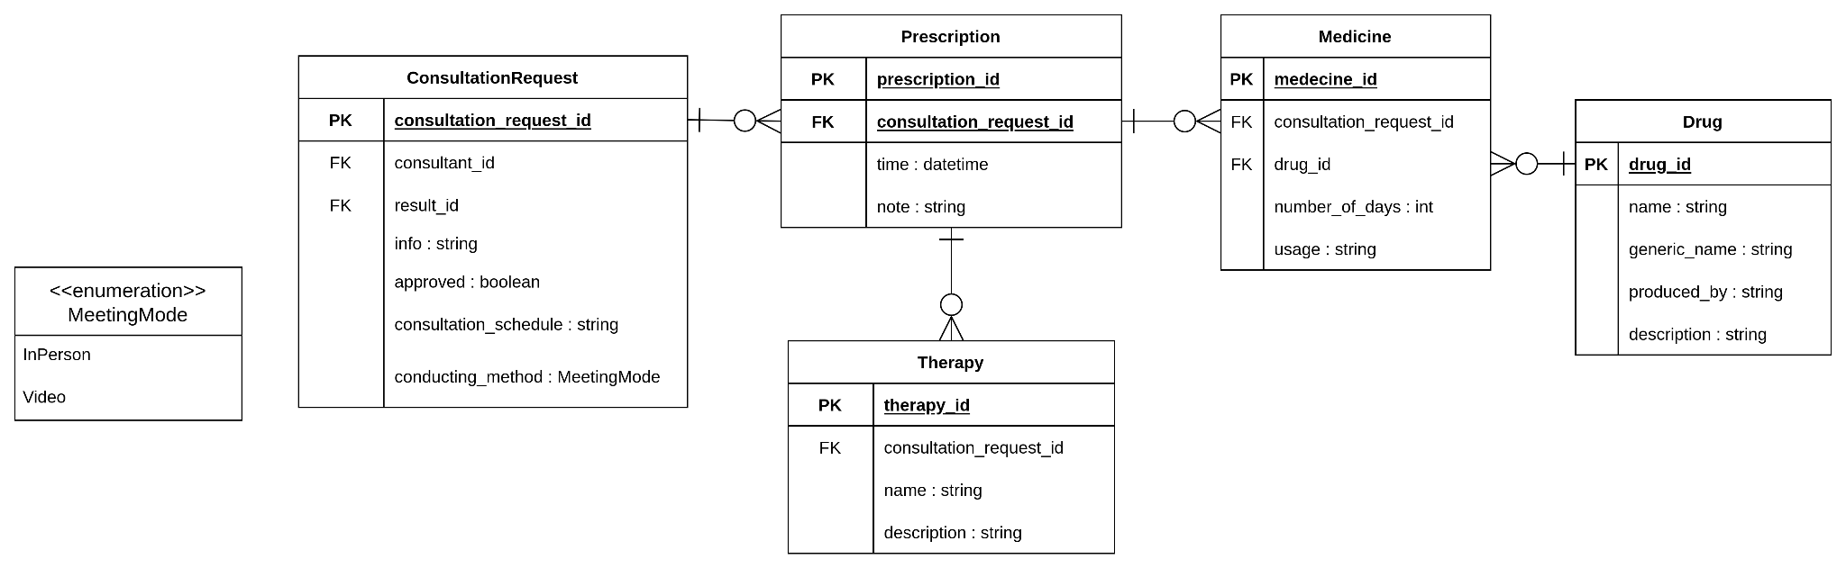
Consultation

Slide 12
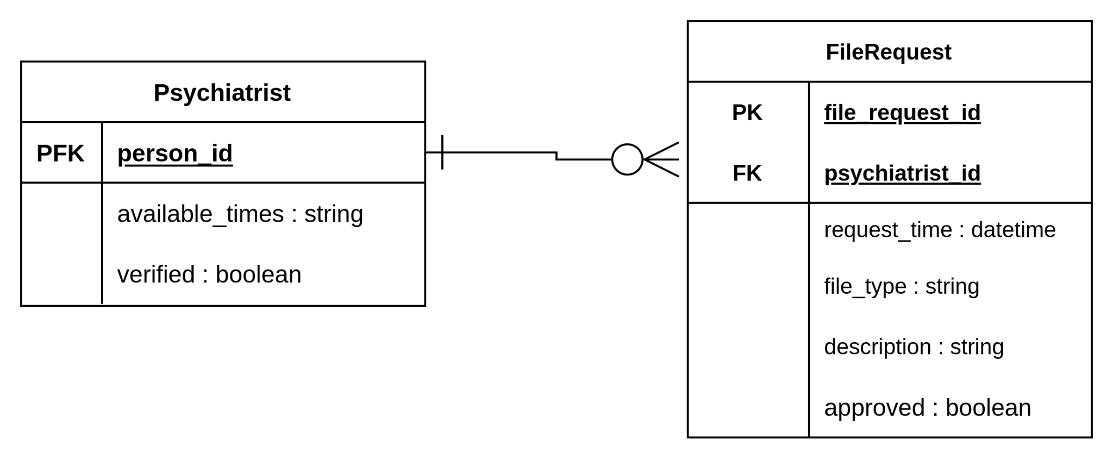
File Request

Slide 13
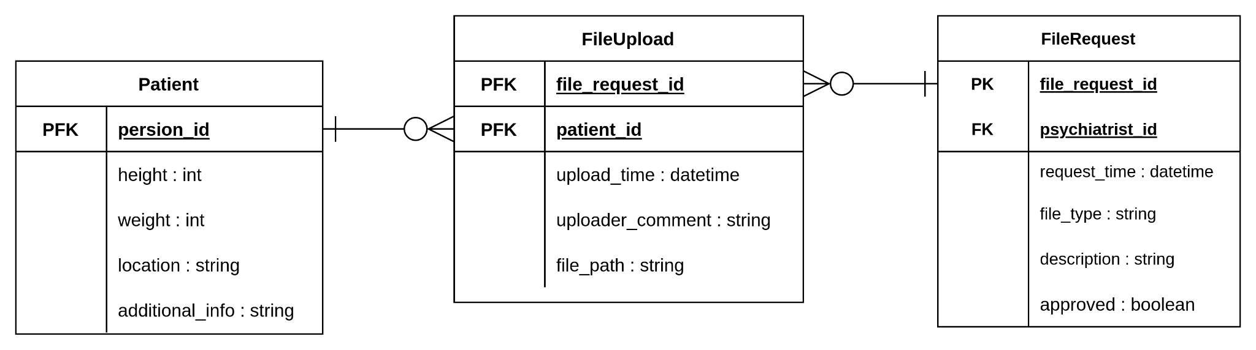
File Upload

Slide 14
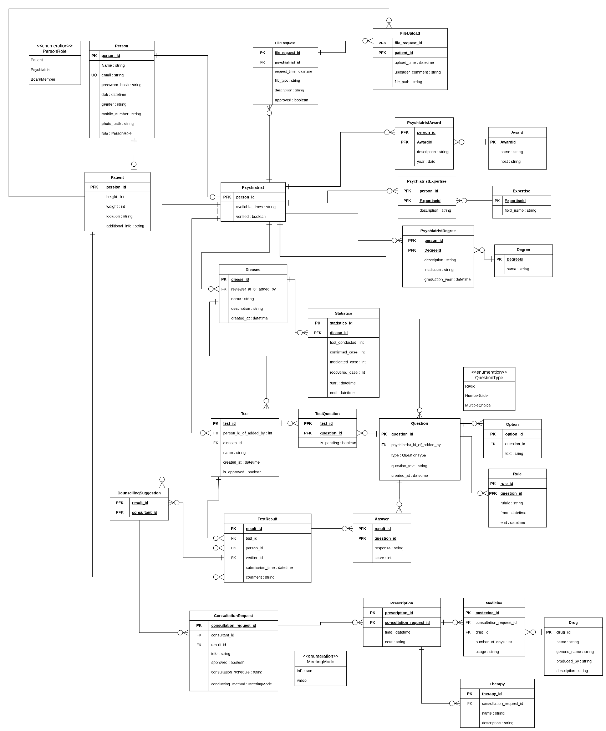

Slide 15
Thank You

